Slide 1
Freud’s Mental Model
Id – we are born with the id, which contains the “instincts” and “libido.” (Relates to Darwin’s internal needs for survival and procreation).
Ego – we develop the ego as we become more aware of the difference between our inner urges and our environment. (relates to personality)
Super-ego – the development of conscience, or the “ego-ideal.” Also considered an “ego-potential.” (going from ego to super-ego is like going from a real-self to an ideal-self)

Slide 2
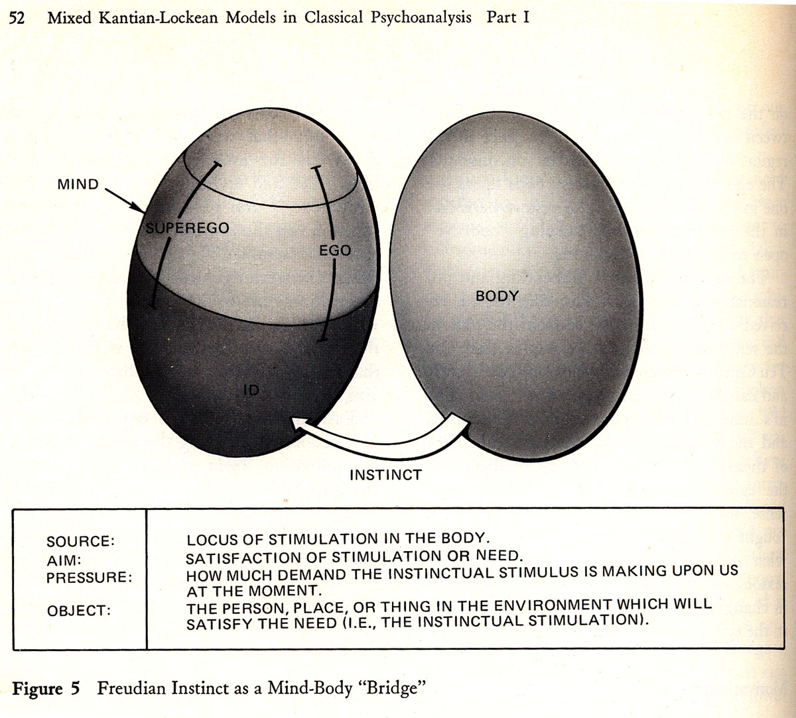

Slide 3
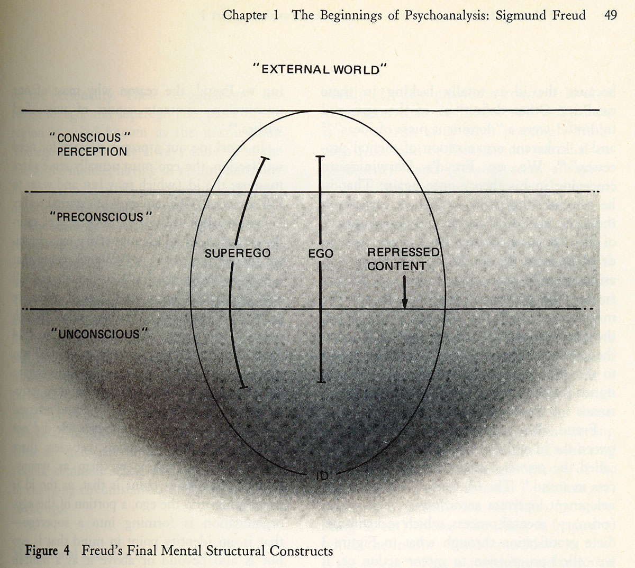

Slide 4
Psychosexual Stages
Freud proposed that the sex-drive (Libido) developed in stages (was the first psychological stage theory).
Oral (0-1) – finding gratification via the mouth.
Anal (1-2) – pleasure in controlling urges. (being anal-retentive leads to a neatness instinct)
Phallic (3-5) – we become aware of pleasure within our sexual organs. We develop sex-roles (men fear castration, women express penis-envy). We also begin to relate to our parents sexually (develop our respective Oedipus/Electra complexes). Ego develops.

Slide 5
Psychosexual Stages
Latency (6-puberty) – we learn to replace our sexual urges with other activities (We learn to sublimate), and we begin developing ego-defense mechanisms, such as
  Repression - most common mechanism
  Rationalization – consciously false justification
  Reaction formation – (for taboos) giving the opposite reaction of instinctive reaction (covering eyes during a movie’s nude scene)
  Others include sublimation, displacement, projection, identification with authority.

Slide 6
Psychosexual Stages
Genital stage (puberty-death) – when puberty hits, the id (and related urges) overcome the latency stage and its mechanisms.
  At this point, a person has unconscious needs (id) rising up to the surface, and meeting the resistance of the defense mechanisms.
  This is where normal and abnormal responses to id urges are developed.
Overall, it is a model of human development, conscience, sexuality, personality, and abnormalities, all in one.

Slide 7
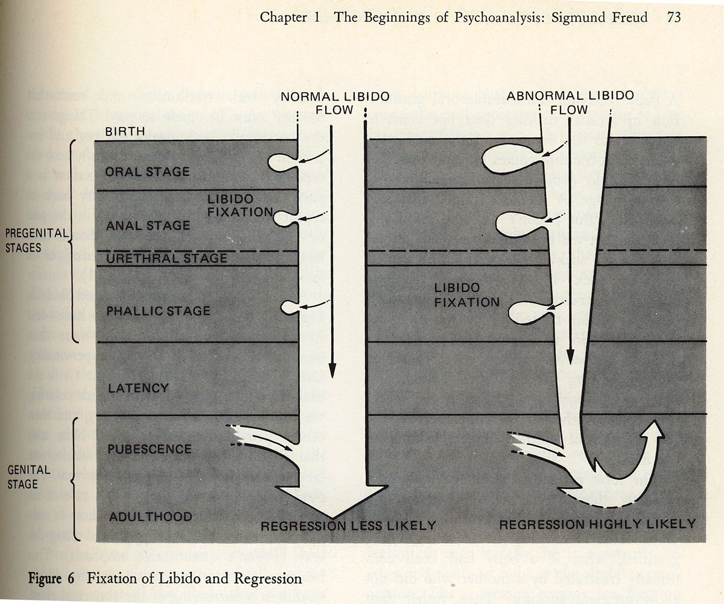

Slide 8
Freud’s Theories of Illness
ANTITHETIC IDEAS & COUNTERWILL
INTENTIONS vs. EXPECTATIONS PROPER
SUBJECTIVE UNCERTAINTY
DISTRESSING ANTITHETIC IDEAS

Slide 9
Sex and Neurosis
COITUS INTERRUPTUS & CHILDHOOD MOLESTATION
Sexual Frustration = Mental illness
Childhood Sexual Molestation = Adult Mental Illness
FREUD’S CORRECTED THESIS
  Actual Past vs. Memories of Fantasies

Slide 10
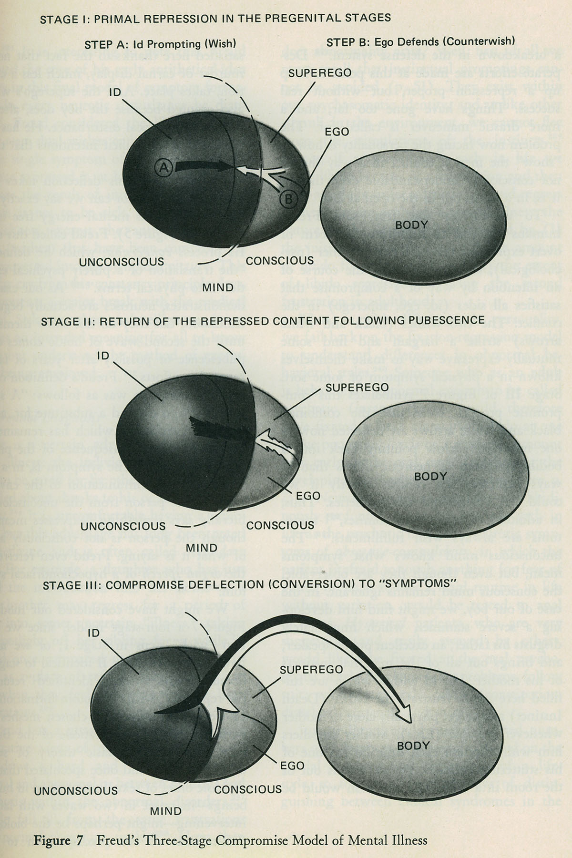
Freud’s Final Theory of Illness

Slide 11
www.youtube.com/watch?v=enmxcvdYEGc

Slide 12
Freud’s Theories of Cure
Role of Insight
A neurotic is suffering from hidden meanings buried deep in the unconscious.
Steps to an insightful understanding for a client
  Determining when and why Primal Repression occurred.
  Assuring patient that a different course of action in life can be taken
  Stressing all the positive changes in client’s life since primal repression.

Slide 13
Freud’s Final Theory of Cure
To be cured the Neurotic must re-enact his Oedipal or her Electra complex in the therapeutic relationship.
Freud called this a “transformed neurosis”, currently called a “transference neurosis”
What’s going on? The neurotic is projecting imagos (figures) from his/her childhood onto the person of the analyst.
What you have is a full blown re-enactment of Oedipal or Electra complex.

Slide 14
How is the Neurotic Cured?
Transference Neurosis
The full- blown re-enactment of the of the Oedipal or Electra complex becomes the vehicle of cure.
The emotions are real.
Positive Transference – love, lust, exaggerated admiration
Negative Transference – hate, disdain, death wishes

Slide 15
How is the Neurotic Cured?
  Flow of Libido
  REPRESSION (Libido used to keep repressed content out of conscious awareness)
  TRANSFERECE (libido used to re-enact Oedipal or Electra drama with analyst as surrogate)
  CURE (liberated Libido is re-invested in client’s ego)

Slide 16
www.youtube.com/watch?v=xDbe0WD-aMI
www.youtube.com/watch?v=xDbe0WD-aM/

Slide 17
Final Comments
Freud made many modifications to his theory as time passed, and other psychoanalysts proposed many, many more changes.
Researchers commonly criticize Freud’s lack of experiments and statistics, as well as the lack of falsifiability in his presentation of theory.
The MOST IMPORTANT criticism, though, asks if Freud is truly overcoming resistance, or merely creating something out of nothing.

